Slide 1

Employee Task Management System
Presented by:
Rohit R. Moharir-[92387]
Rutik P. Shelke-[92401]
Prathmesh S. Bastawade-[92409]
Vedprakash B. Umare-[92415]
(Batch: KD-1)

Slide 2





Project Overview & Objectives
What We're Building
The Employee Task Management System is a comprehensive Java-based web application designed to revolutionize how organizations manage their workforce and projects.
This centralized platform automates the entire lifecycle of task assignment, tracking, and monitoring, enabling supervisors to efficiently oversee employees across multiple concurrent projects while ensuring accountability and timely delivery.
Automate Management
Efficient Assignment
Leverage Java technology to streamline project and
task workflows
Help supervisors assign and track employee tasks with precision
Real-Time Tracking
Timely Delivery
Provide live project progress visibility across all teams
Ensure projects complete on schedule through proactive
monitoring
Batch:KD-1

Slide 3





Functional Requirements
Our system encompasses five core functional domains that work together to create a seamless task management experience:
User Management
Comprehensive authentication, authorization, and profile administration for all system users
Project & Task Management
Creation, assignment, and organization of projects with granular task breakdowns
Task Tracking & Monitoring
Real-time progress updates, status changes, and milestone tracking
Employee Interaction
Collaborative features including comments, queries, and task-related communication
Reporting & Dashboard
Comprehensive analytics, performance metrics, and visual progress dashboards
Batch:KD-1

Slide 4






User Roles & Permissions
The system implements a hierarchical role-based access control model with three distinct user types, each with specific responsibilities and system privileges:
Admin
System-wide control
Manager
Project oversight & task delegation
Employee
Task execution & progress updates
Admin
Manager
Employee
Full system administration including user management, project creation, and organizational oversight
Project-level control with task assignment, tracking, and team performance monitoring capabilities
Task-focused interface for viewing assignments, updating progress, and communicating with managers
Batch:KD-1

Slide 5
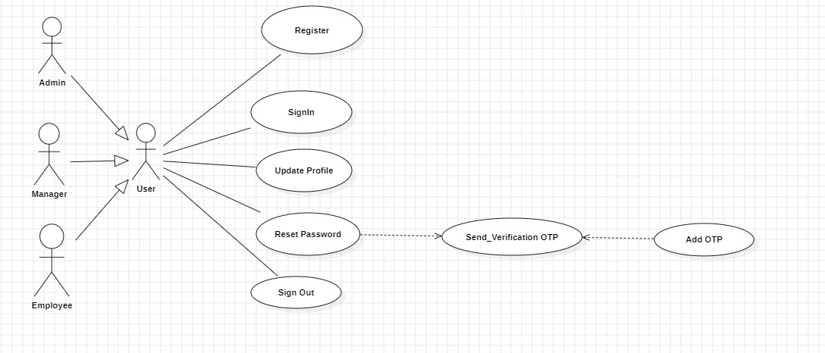
System Use-Case Diagram
The comprehensive use-case diagram below illustrates the complete interaction model between all user roles and system functionalities, providing a holistic view of system capabilities:
This diagram demonstrates the relationships between actors (Admin, Manager, Employee) and the various use cases they can initiate, including authentication flows, task management operations, and reporting functions.
Batch:KD-1

Slide 6
Admin Capabilities
The Admin role serves as the backbone of system administration, wielding comprehensive control over organizational structure, user management, and project initialization:
1
2
3
User Account Management
Project Administration
Comprehensive Reporting
Create, modify, and remove employee and manager accounts with full profile control and permission settings
Initialize new projects, define project parameters, set deadlines, and manage project lifecycles from conception to completion
Generate system-wide reports including user activity, project status, resource allocation, and performance analytics
4
5
Manager Assignment
Security Management
Strategically assign managers to projects based on expertise, availability, and organizational requirements
Reset user passwords, manage access credentials, and maintain system security protocols
Batch:KD-1

Slide 7
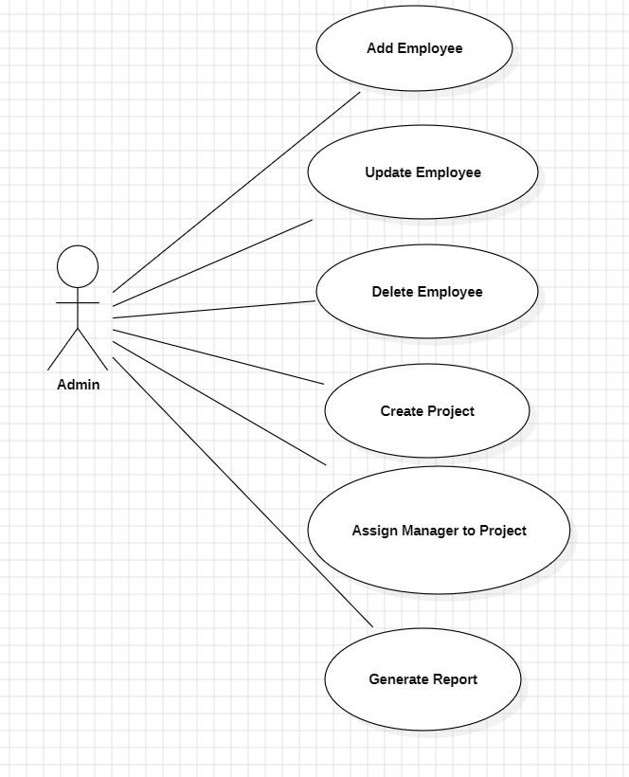
Admin Use-Case Diagram
Administrative Workflows
The Admin use-case diagram details the specific system interactions available to administrators, emphasizing their central role in system configuration and oversight.
Key interactions include:
User lifecycle management (creation, updates, deletion)
Project initialization and configuration
Manager-to-project assignments
System-wide reporting and analytics
Security and access control management
Batch:KD-1

Slide 8





Manager Functional Requirements
Managers occupy the critical middle tier, bridging organizational strategy with tactical execution through comprehensive project oversight and team coordination:
Project Visibility
Task Delegation
Progress Tracking
Access and review all assigned projects with complete task breakdowns and team compositions
Assign specific tasks to employees based on skills, availability, and workload balancing
Monitor real-time task status, identify bottlenecks, and ensure continuous forward momentum
View assigned projects and understand scope
Assign and distribute employee tasks strategically
Update task details, priorities, and deadlines dynamically
Track task progress with visual dashboards
Generate detailed project and task performance reports
Batch:KD-1

Slide 9
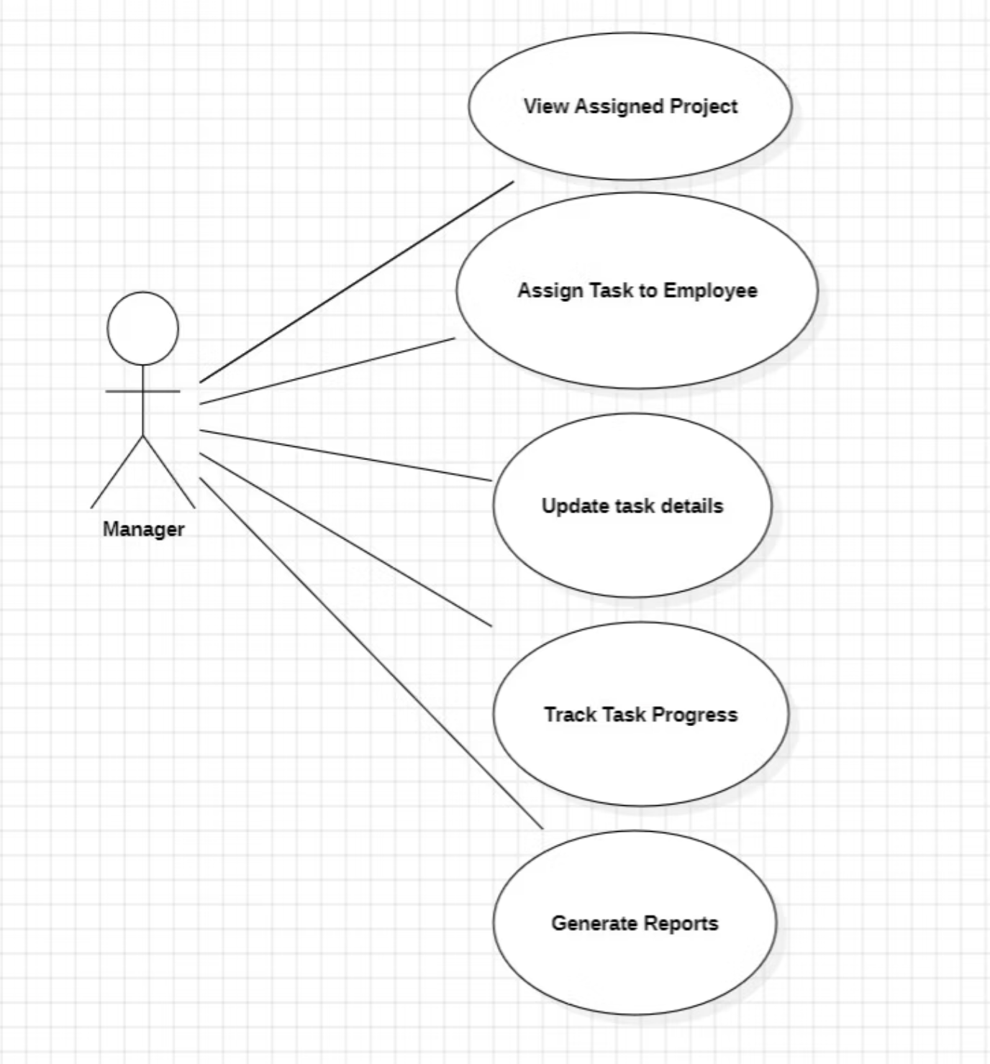

Manager Use-Case Diagram
Manager Interactions
This use-case diagram illustrates the Manager's operational scope within the system, highlighting their pivotal role in translating projects into actionable tasks.
Key Capabilities: Managers can view project portfolios, create and modify task assignments, monitor employee progress, adjust deadlines, and generate performance reports—all essential for effective project delivery.
Batch:KD-1

Slide 10
Employee Functional Requirements
Employees represent the execution layer, interacting with the system to understand their responsibilities, communicate progress,
and deliver results:
Registration & Authentication
1
Secure account creation and login procedures with credential management
2
Task Visibility
View complete list of assigned tasks with priorities, descriptions, and deadlines
Status Management
3
Update task progress through defined workflow: Pending → In Progress → Completed
4
Communication
Submit comments, upload queries, and request clarification on task requirements
Profile Management
5
Maintain and update personal information, contact details, and professional credentials
These capabilities empower employees to take ownership of their work while maintaining transparency and accountability throughout
the task lifecycle.
Batch:KD-1

Slide 11
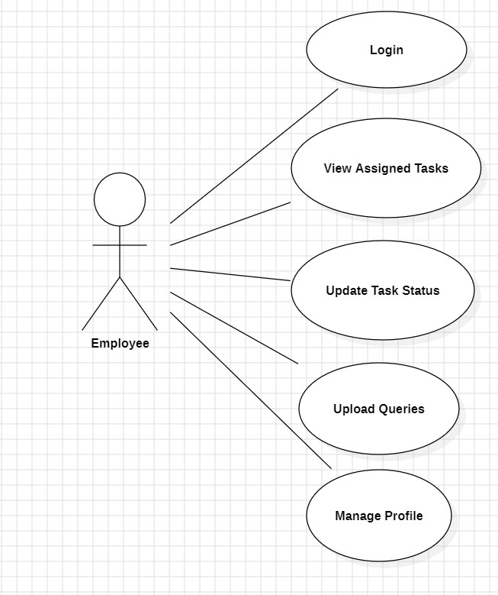
Employee Use-Case Diagram
Employee Interactions
This use-case diagram illustrates the Employee operational scope within the system, highlighting their pivotal role in translating projects into actionable tasks.
Key Capabilities: Employee needs to login , view assigned tasks, Update Task Status, Upload Queries and Manage Profiles—all essential for effective project delivery.
Batch:KD-1

Slide 12
THANK YOU !!
Batch:KD-1

